Slide 1



SQL – REINFORCEMENT PROJECT
YASHWANTH K
DA & DS
BATCH NOV - 24
2025/01/06

Slide 2
INTRODUCTION
I Have used Imdb Database For these Queries and Solve them using SQL in this project .
Imdb Database have 6 tables :
Movie
Genre
Names
Rating
Director_Mapping
Role_Mapping

Slide 3
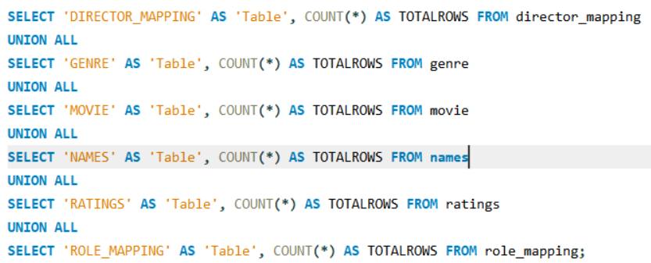
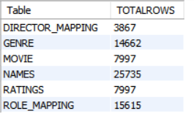
1. Find the total number of rows in each table of the schema
QUERY
OUTPUT

Slide 4
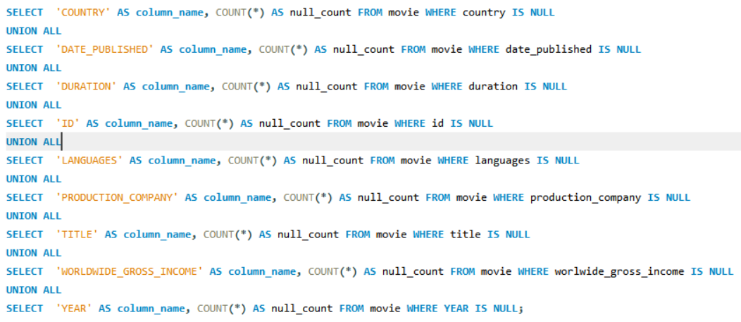
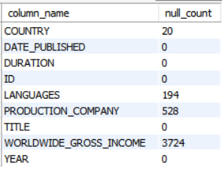
2. Which columns in the movie table have null values
QUERY
OUTPUT

Slide 5


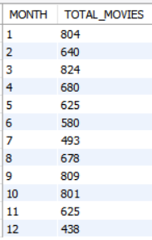
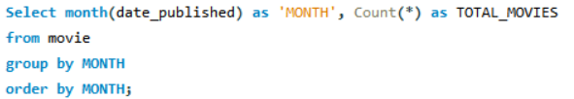
3A .Find the total number of movies released each year.
OUTPUT
QUERY
3B. How does the trend look month-wise?
OUTPUT
QUERY

Slide 6
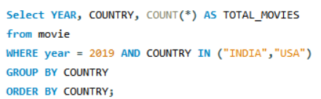

4. How many movies were produced in the USA or India in the year 2019?
QUERY
OUTPUT

Slide 7


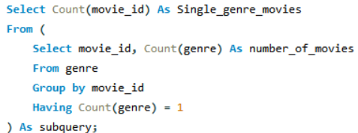

5A. Find the unique list of genres present in the dataset.
OUTPUT
QUERY
5B. how many movies belong to only one genre
QUERY
OUTPUT

Slide 8
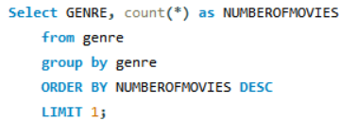

6. Which genre had the highest number of movies produced overall?
QUERY
OUTPUT

Slide 9
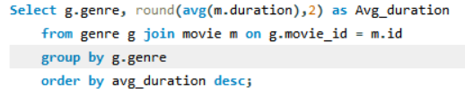
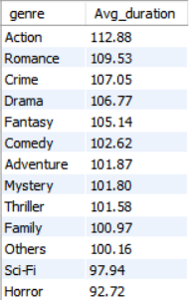
7. What is the average duration of movies in each genre?
QUERY
OUTPUT

Slide 10
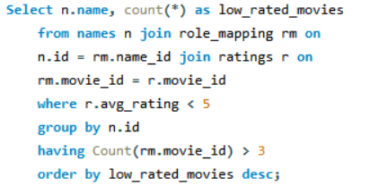
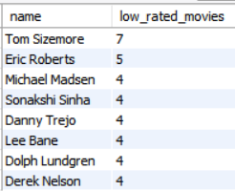
8. Identify actors or actresses who have worked in more than three movies with an average rating below 5?
QUERY
OUTPUT

Slide 11
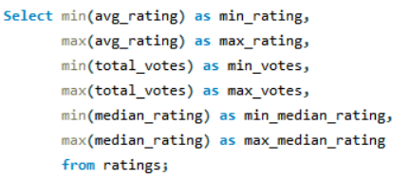
9. Find the minimum and maximum values in each column of the ratings table except the
movie_id column.
QUERY
OUTPUT

Slide 12
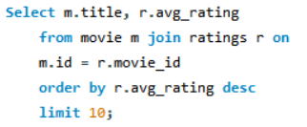
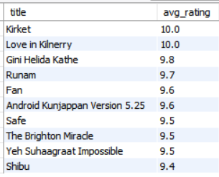
10. Which are the top 10 movies based on average rating
QUERY
OUTPUT

Slide 13
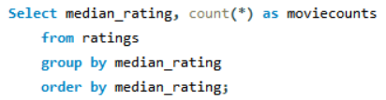
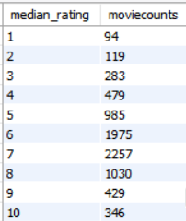
11. Summarise the ratings table based on the movie counts by median ratings
QUERY
OUTPUT

Slide 14
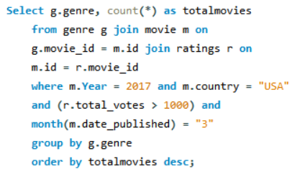
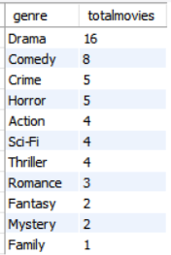
12. How many movies released in each genre during March 2017 in the USA had more than 1,000 votes?
QUERY
OUTPUT

Slide 15
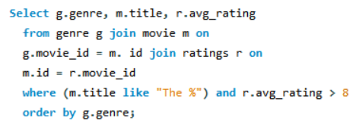
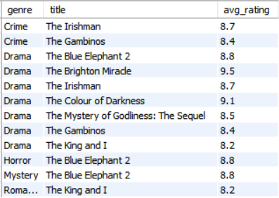
13. Find movies of each genre that start with the word ‘The ’ and which have an average rating > 8
QUERY
OUTPUT

Slide 16
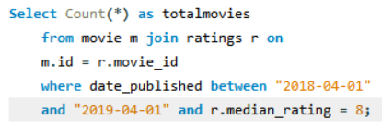

14. Of the movies released between 1 April 2018 and 1 April 2019, how many were given a median rating of 8?
QUERY
OUTPUT

Slide 17
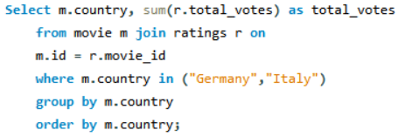

15. Do German movies get more votes than Italian movies?
QUERY
OUTPUT

Slide 18
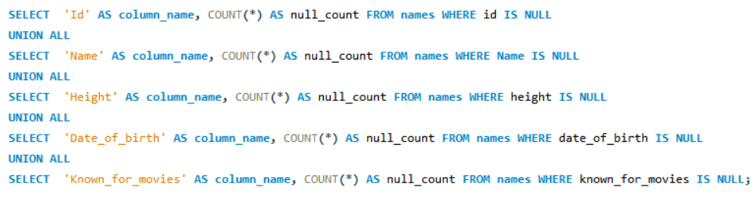
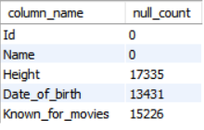
16. Which columns in the names table have null values
QUERY
OUTPUT

Slide 19
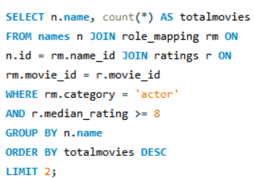

17. Who are the top two actors whose movies have a median rating >= 8?
QUERY
OUTPUT

Slide 20
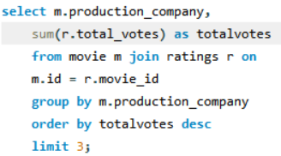

18. Which are the top three production houses based on the number of votes received by their movies?
QUERY
OUTPUT

Slide 21
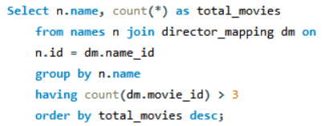
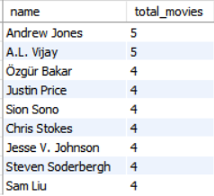
19. How many directors worked on more than three movies?
QUERY
OUTPUT

Slide 22
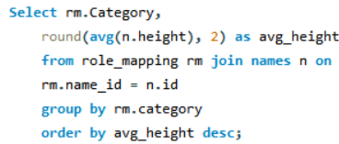

20. Find the average height of actors and actresses separately
QUERY
OUTPUT

Slide 23
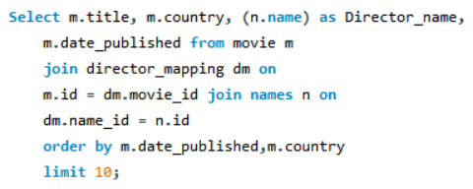
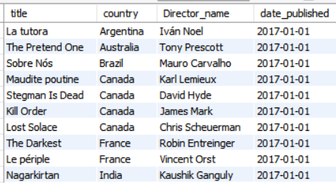
21. Identify the 10 oldest movies in the dataset along with its title, country, and director
QUERY
OUTPUT

Slide 24
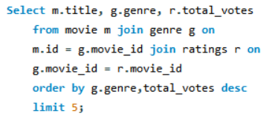
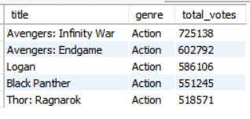
22. List the top 5 movies with the highest total votes and their genres
QUERY
OUTPUT

Slide 25
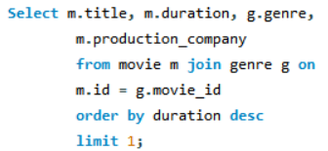

23. Find the movie with the longest duration, along with its genre and production company.
QUERY
OUTPUT

Slide 26
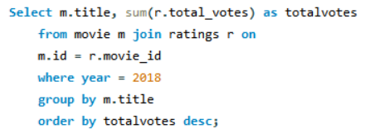
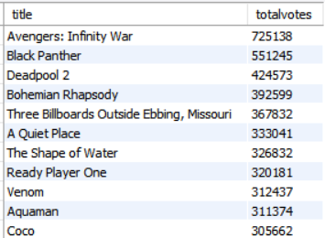
24. Determine the total votes received for each movie released in 2018
QUERY
OUTPUT

Slide 27
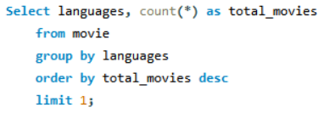

25. Find the most common language in which movies were produced.
QUERY
OUTPUT

Slide 28
INSIGHTS & CONCLUSION
Using the Imdb Database, I have some Insights :
Year – 2017, Total Movies
Mar – Total Movies - 824 , Dec – Total Movies - 438
USA – More Movies –> India – UK.
Top Rating – Movie – (Kirket) - 10.0, Low Rating – Movie – (Ritoru Kyouta no bouken) – 1.0
Director – Top - Srinivas Gundareddy , Low – Satsuki Okawa

Slide 29


